Slide 1
The World Bank, Islamic Finance and
Sustainable INVESTING
Abu Dhabi
April 2015
Michael Bennett
Head of Derivatives /Structured Finance

Slide 2
Structure of the Presentation
The World Bank’s Sukuk Transactions
The Story behind the “Vaccine Sukuk”
The Growth of Conventional Sustainable Investing and its relevance for Islamic Finance

Slide 3
World Bank
Transactional Work in Islamic Finance
    First Islamic capital markets transaction:
      Malaysian domestic issue in 2005
        MYR 760 million 5 year issue
December 2014, “Vaccine Sukuk” for the International Finance Facility for Immunisation (“IFFIm”)
        US$500 million 3 year transaction
        Floating rate based on commodity murabaha

Slide 4
What is IFFIm?
International organization established in 2006 to frontload funding for immunization in the poorest countries of the world
Supported by nine sovereign governments
No staff of its own - World Bank acts as IFFIm’s Treasury Manager
Provides funds for immunization through GAVI, the Vaccine Alliance

Slide 5





IFFIm Donors
Governments have entered into long-term legally binding grant agreements with IFFIm, which has been constructed to accommodate additional donors.
Donors | Ratings (as of 28 March 2014) | Grant (US$ equivalent)
United Kingdom | AA+/Aa1/AAA | US$ 2,980 million
France | AA+/Aa1/AA | US$ 1,719 million
Italy | BBB+/Baa2/BBB | US$ 635 million
Norway | AAA/Aaa/AAA | US$ 264 million
Australia | AAA/Aaa/AAA | US$ 256 million
Spain | BBB+/Baa2/BBB | US$ 240 million
The Netherlands | AAA/Aaa/AA+ | US$ 114 million
Sweden | AAA/Aaa/AAA | US$ 38 million
South Africa | BBB/Baa1/BBB- | US$ 20 million
Approximately US$6.3 billion
Brazil (BBB/Baa2/BBB-) has also been considering a grant to IFFIm of US$ 20 million

Slide 6
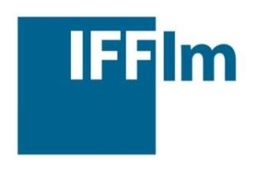


IFFIm Structure
Government donors’ long-term financial pledges
$ $ $
Vaccination Programmes
Bonds
$ £ A$
Capital Markets Investors

Slide 7
IFFIm
Value of Frontloading
By accessing the capital markets, IFFIm provides money up front that would
otherwise only be available over 20 years.

Slide 8
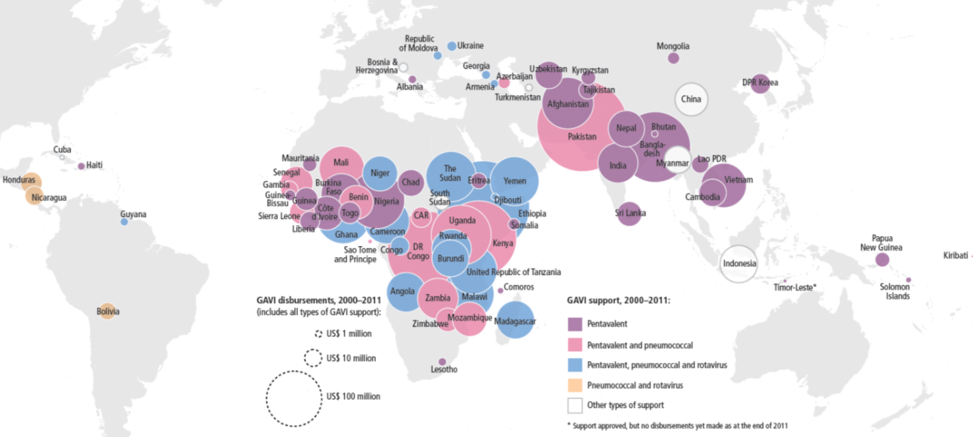
Use of IFFIm Funds
60% of annual global births are in GAVI-funded countries
Type and value of support, 2000–2011
Source: Gavi, 2012

Slide 9
Vaccine Sukuk
Summary Terms
Issuer: | IFFIm Sukuk Company Limited
Obligor: | IFFIm
Issue Type: | Senior, Unsecured Trust Certificates
Issue Rating: | Aa1 (Moody’s)
Issue Date: | December 4, 2014
Maturity Date: | December 4, 2017
Profit Rate: | USD 3 month LIBOR + 15 bps (quarterly)
Governing Law: | English
Joint Leads: | Standard Chartered (Global Coordinator), Barwa Bank, CIMB, NBAD, NCB Capital
Co-Managers: | BIBD, Union Bank

Slide 10
Vaccine Sukuk
Difficulties / Benefits
Difficulties | Benefits
IFFIm has no significant tangible assets (limited structural options) | IFFIm investor base concentrated in US, Europe, Japan and Australia – expand to MENA and SE Asia
No one involved with IFFIm had experience with Islamic finance (eg, accountants, lawyers, back office staff) (big learning curve) | IFFIm/GAVI not well known in MENA and SE Asia – increase awareness
Sukuk Investors not familiar with IFFIm | Potential to obtain cost effective funding in large size

Slide 11
Vaccine Sukuk
Distribution

Slide 12
Vaccine Sukuk
“Firsts”
First MENA and SE Asian focused transaction for IFFIm
Largest Debut Sukuk by a Supra-National
Largest International Sukuk al-Murabaha
First International Sukuk for a Charitable Purpose

Slide 13
Conventional Sustainable Investing
Original “sustainable investing” was boycotts against sinful industries on mainly religious grounds
      Slave trading, alcohol
In the 60’s and 70’s, grew beyond religious context to include investment boycotts for political reasons
      Companies involved in Vietnam War, South Africa
Since the 90’s, has grown beyond single issue focus to be recognized investment strategy

Slide 14
Sustainable Investing
Market Size

Slide 15
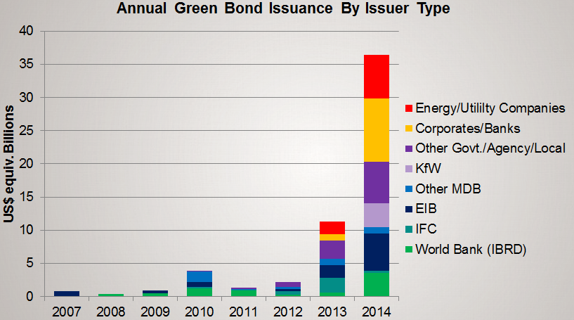
Sustainable Bond Investing
Growth of Green Bond Market

Slide 16
Sustainable Investing
What it can offer Islamic Finance
Problem for Islamic finance: Excessive reliance on “negative screening”
      Sukuk structures focus on avoiding interest
      Can lead to a sense of form over substance
Solution offered by Sustainable Investing:
      Move to positive rather than negative screens
        “Impact Investing”
      Focus on investments that promote social, environmental or governance changes/results

Slide 17
Disclaimers
The findings, interpretations and conclusions expressed herein are those of the presenter and do not necessarily reflect the views of the World Bank or its affiliated organizations.
This presentation has been prepared for informational purposes only, and the presenter makes no representations or warranties of any kind as to the accuracy or completeness of any of the information contained herein.

